Slide 1
705.741 Battleship
Affan Dhankwala & Robert Franckowiak
EN.705.741.8VL Reinforcement Learning
22 April 2025

Slide 2
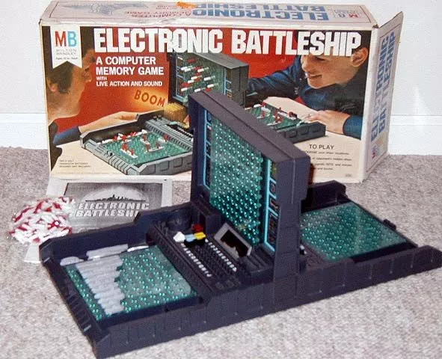
Inspiration
Battleship
Board game between two players
Each player places their a set of ships
Once ships are placed, the players will take turns guessing the coordinates of the opponents ships.
The opponent must respond as to whether the guess was accurate (hit) or inaccurate (miss).
The player who’s ships sink first loses
Source: https://boardgamegeek.com/image/12546/electronic-battleship

Slide 3
Game
Altered version of game
We wish to create a varied version of this game with the following restrictions
The agent will only be responsible for sinking an opponent’s boat.
The agent will not place it’s own boats.
The agent will be given a hit at the start of an episode.
The goal of the agent is to finish sinking the boat with as few actions as possible.
Smaller grid - 5x5.
The agent is only aware of whether a particular shot hit or missed
The agent’s only action is to shoot (and pick what location to shoot)

Slide 4
Game Complexity:
States
5 x 5 state space = 25 possible grid locations but first hit is given (24 unknown spots)
Each grid location could be either unexplored or hit/miss (2 states)
The number of possibilities per ship:
5-length: 10 possibilities
4-length: 20 possibilities
3-length: 30 possibilities
2-length: 40 possibilities
1 terminating state for a sunken ship (win)
Total states = (10+20+30+40) * 2^(24) + 1= 1,677,721,600 states
Rewards
The following reward function was utilized
Hit: 1 pt
Miss: -1 pt
Win: 10 pt

Slide 5
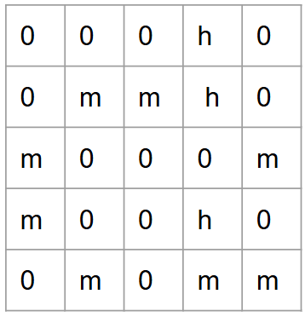
Environment
The environment will hold the game state
A grid that looks like this:
Is represented as “000h00mmh0m000mm00h00m0mm”
Grid read left to right, top down
h is hit
m is miss
0 is unexplored
Allows for each game state to be keyed within the q table dictionary.

Slide 6
Agents
Q Learning off policy agent
SARSA on policy agent
Random agent

Slide 7
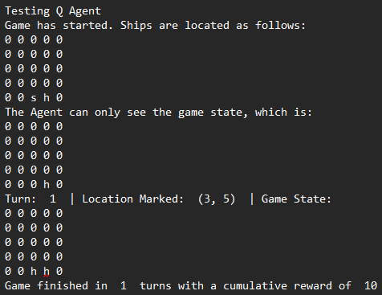
Demo (1)
Q Agent:

Slide 8
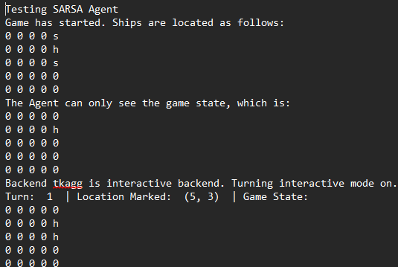
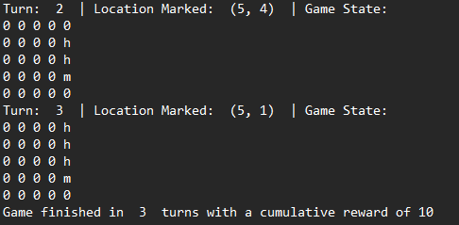
Demo (2)
SARSA Agent:

Slide 9
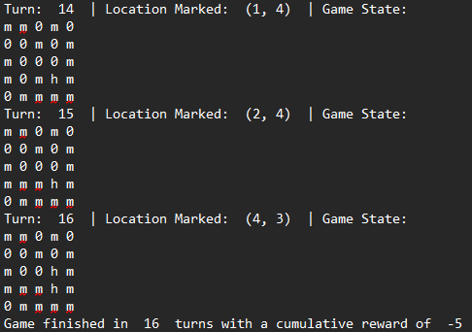
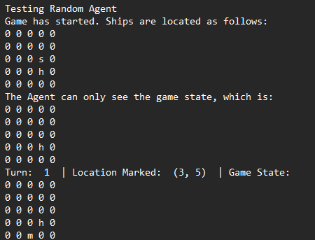
Demo (3)
Random Agent:
. . .

Slide 10
Results (1):
Set the hyperparameters as follows
Learning rate (alpha): 0.1
Discount (gamma): 0.9
Rewards: 1 (hit), -1 (miss), 10 (win)
Testing strategy
50 Q Agents trained on 100,000 episodes
50 SARSA Agents trained on 100,000 episodes
50 Random Agents running through 100,00 episodes
Explore/exploit dictated by decaying e rate
All agents operated at 0.01 exploration for at least the final 50 episodes

Slide 11
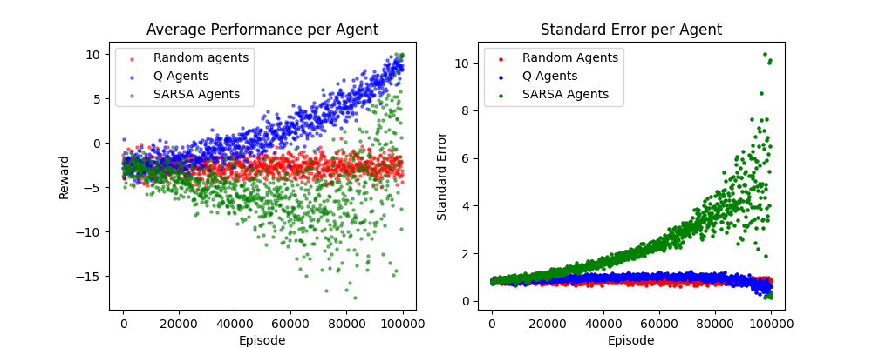
Results (2):
Graph (Only show every 100th episode to reduce clutter):

Slide 12
Results (3):
Performances of final 50 episodes
Agent Type | Average Reward | Average Median
Q Agent | 8.4856 | 8.55
SARSA | 6.2352 | 7.48
Random Agent | -2.484 | -2.5

Slide 13
Analysis
Both Q Learning and SARSA Agents performed much better than the random agent
Q Learned learned consistently and quickly
SARSA had erratic behavior, which may be due to SARSA updating the Q-table based on random policies during exploration, compared to Q-Learning updating based on the greatest value off-policy actions

Slide 14
Next steps
Allow model to scale the size of matrix
Ability to guess multiple ships
Allow the user to create custom ships and place them
Attempt to have two against one another

